Slide 1
Fundamentals Of Infrastructure security
Joseph Rice
12.17.22

Slide 2
Intro
This course develops knowledge and skill in infrastructure security implementations.
Topic Insights
Threat Intelligence
Identification of security vulnerabilities
Cloud Security
Security Data Analysis
Incidence Response
Risk Management
IT Regulatory Compliance

Slide 3
VM Utilized
-DMZ Machine
-Easy
-Firewall Machine
-Malware
-OWASP-BWA
-Security Onion IDS
-Ubuntu Web

Slide 4
Manual Vulnerability Analysis
Within this section we carried out an exercise on
- NMAP Scripting Engine
- Microsoft windows Bulletin MS08-067 Vulnerability
-Microsoft Windows Bulletin MS17-010 Vulnerability

Slide 5
Manual Vulnerability Analysis Cont.
Microsoft Windows Bulletin MS08-067 Vulnerability
To check for the vulnerability, I used the manual capability of the nmap scripting engine tools.
In the Terminal window of the Ubuntu Web machine, I entered cd /usr/share/nmap/scripts
This placed me in the directory for the scripts. I than Entered ls *vuln* to display the vulnerability checks that are contained within the script’s files.

Slide 6
Microsoft Vulnerability MS08-067
This screenshot shows that the ms08-067 vulnerability exists on the VM machine

Slide 7
Microsoft ms017-010 vulnerability
This screenshot shows that the Ms017-010 vulnerability exists on the vm machine

Slide 8
Intrusion Analysis using Wireshark

Slide 9
Intrusion Analysis using Wireshark cont.
Within this section I have conducted fundamental protocol analysis activities including the following:
-Basic Protocol Analysis
-Using Display Filters To Extract Data
-Common Attacks
-Basic attack analysis

Slide 10
Intrusion Analysis Using Wireshark Q & A
1. Looking at captures no. 20 and 22. Both packets are ICMP traffic but there are subtle differences between them. Compare the time-to-live and data field sizes in the two packets. What differences do you see?
There are subtle differences in the TTL and SEQ of no.20 and no.22. Those differences are as follows. The time-to-live in n0.20 is 64 and the time-to-live in packet 22 is 128. The seq is 5/1280 for packet 20 and the seq for packet 22 is 768/3.
2. Do a little Internet research to discover which operating systems use the specific values in their ping commands. What operating system generated the echo request in capture 20?m.
Based upon my research the operating system that delivers a 64 TTL is the Linux/Unix operating system so np.20 would run on the Linux/Unix operating System. No.22 has a TTL of 128 and upon research Windows TTL value is 128 so no.22 is running on a Windows operating system.

Slide 11
Intrusion Analysis Using Wireshark Q & A
3. Review packet no. 37 and beyond, what do you think is taking place here?
At packet 37 we begin to see TCP protocol along with SYN. Syn packets are typically created when one-point attempts to start a TCP connection to a server and exchange a series of data. SYN is suspicious and a SYN flood is a form of attack in which an attacker rapidly initiates connection to a server withing finalizing the connection. While it tried to finalize multiple connections, it can create enough traffic to make the system unresponsive to live traffic. I believe in this case a form or pattern of attack is occurring.
4. Look at capture 22846. What is suspicious about the flag settings in this packet?
The results contain FIN which to my research means FINISH. In the sense that it is more of an issue to fully end the connection because to do so you need each side of the connection by each sending a special message. To me this is not good because one side may be ready to end a connection and the other side may not comply.
5. What is the IP address of the host being targeted?
The IP address that is being targeted is 192.168.25.1

Slide 12
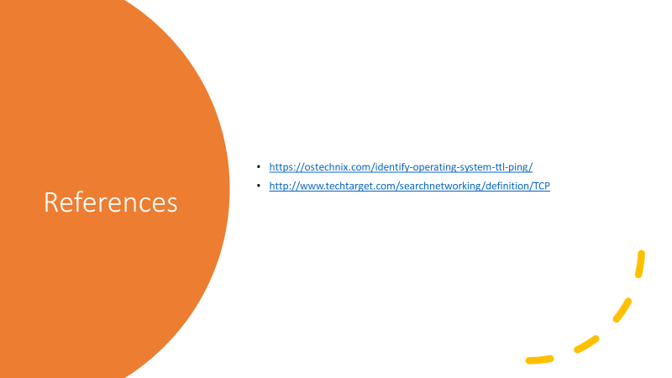
Intrusion Analysis using Wireshark References

Slide 13
Open SSL Analysis

Slide 14
Open ssl analysis (cont.)
In this section of the course, I explored manual Open SSL analysis by creating and testing an SSL/TLS file.
Utilized
-Ubuntu Web
-Wireshark

Slide 15
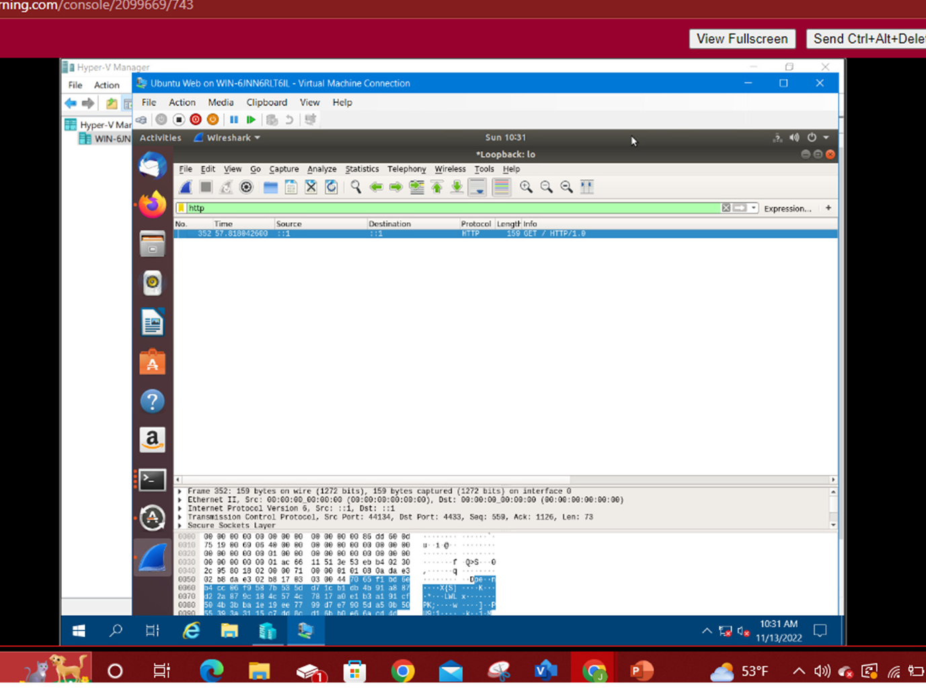
OPEN SSL ANALYSIS
Shown in the screenshot, I disabled the TLS1.3 protection than returned to Wireshark. I than stopped the capture and verified that I received the GET request.

Slide 16
Open SSL cont.
This screenshot shows the decrypted SSL Stream

Slide 17
SNort
In this area I explored snort, which is an open-source network intrusion detection system by testing and creating snort rules. These rules help define malicious network activity and then uses them to identify packets that match them and generate alerts for administrators. Snorts can be deployed inline to to stop these packets. Snort primarily uses a packet sniffer, and it can be downloaded or configured
VM Utilized
-Security onion ids
-ubuntu web
-OWASP-BWA

Slide 18
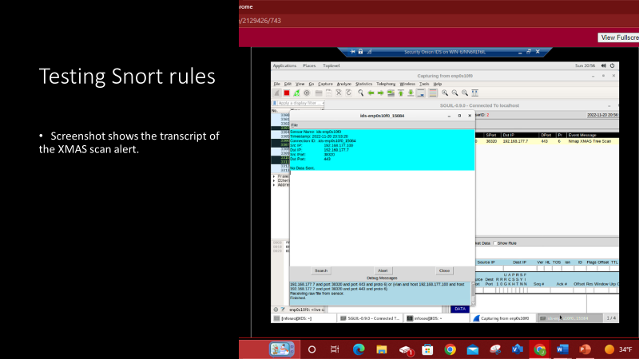

Slide 19
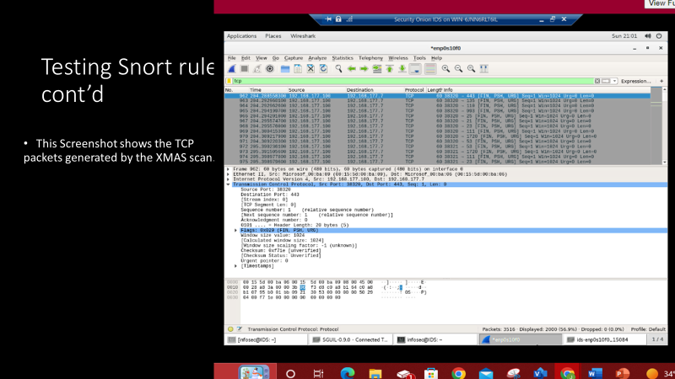

Slide 22
Live Memory Analysis
In this section of the project, I gained familiarity with Linux and Microsoft tools that are used to conduct a live memory analysis. Including topics on:
-Linux processes
-Process hacker
-Process monitor
-Volatility
I also utilized two VM
-ubuntu Web
-Malware

Slide 23
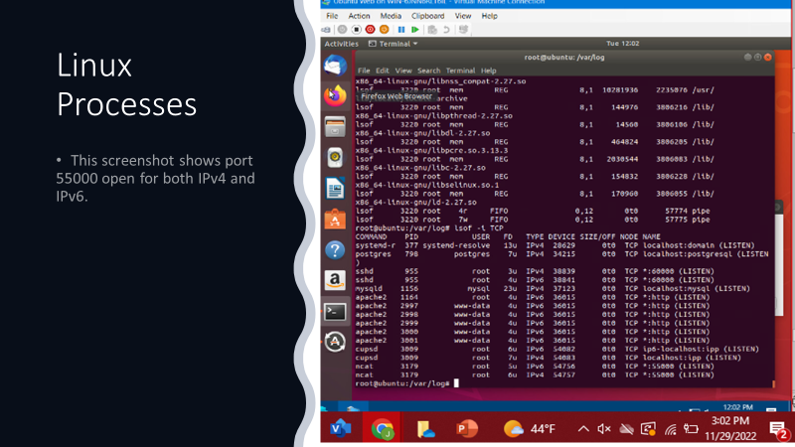

Slide 24
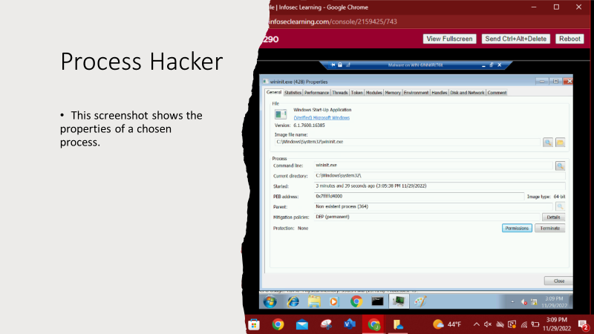

Slide 25
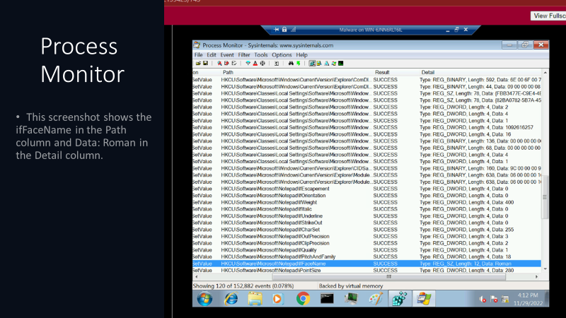

Slide 26
Firewall
In this section of the course project, I configured iptables for network defense in six difference scenarios.
-time based scenarios
-blackhole routing
-bogon filtering
-stateful firewall
-dynamic nat
-brute force of ssh logins
I Utilized Three different Virtual Machines
-ubuntu web
-firewall machine
Dmz machine

Slide 29
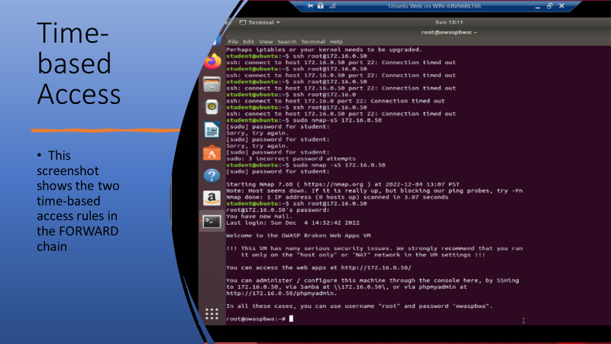

Slide 30
Challenges
During this class I did not face many challenges. I was quite engaged and found that I have a niche for this topic. I really enjoyed the course projects as well as the weekly lessons and class lectures. Thank you for a wonderful experience.

Slide 31
Career Skills gained
Knowledge of risks to the CIA triad and security controls for networks and endpoints
- knowledge in using threat intelligence to support organization security
- ability to perform vulnerability scans and analyze scan reports
- ability to explain threats and vulnerabilities associated with operating in the cloud
- knowledge of software and hardware assurance practices
- knowledge on analyzing security monitoring data
Knowledge of four phases of the incident response process
-knowledge on techniques used to identify, assess and manage risks
-ability to produce a secure network

Slide 32
Conclusion
The fundamentals of infrastructure security course has helped develop my infrastructure security implementation skills as well as expanded my knowledge in threat intelligence, identification of security vulnerabilities , cloud security, security data analytics , incident response, risk management and IT regulator compliances and I look forward to putting these skills into play.

Slide 33
THANK YOU
Joseph Rice

