Slide 1

Fundamentals of Information System Security
- Joseph Rice

Slide 2

Introduction
In This course we explored the fundamentals of information security attacks and defense mechanisms. In this course we dove into the depths of Security issues related to people, data, networks, and devices. As well as gaining insight into designing security solutions and policies. As well as technologies and practices that support the security principles of confidentiality, integrity, and availability.

Slide 3
Introduction
In This Course We Completed The Following.
Described different types of malware.
Identified social engineering attacks.
Differentiated cryptographic algorithms and their applications.
Surveyed network security devices and protocols.
Explained wireless network security solutions.
Interpreted application security, device security, and physical security.
Examined authentication and access control techniques.
Assessed business continuity and risk management strategies.
Explored the evolving job market in the digitized world.
Produced a secure network.

Slide 4
Platforms Utilized
Cengage MindTap
            Online Learning Platform that boosts performance and delivers access to textbooks and a range of study tools.
ITPRO.TV
            eLearning Platform that aims to teach IT in more of a podcast environment with Hosts that give the feel of direct interaction while teaching concepts and having informative conversation.
Microsoft Azure Labs
            Cloud Based computer lab environment that allows a variety of preconfigured virtual machines to be used.

Slide 5
Project Preparation
    Navigate Azures Cloud Platform
    Access Hyper-V Manager
    Successfully Run, Access and Shutdown Ubuntu, Kali and Linux Server

Slide 6
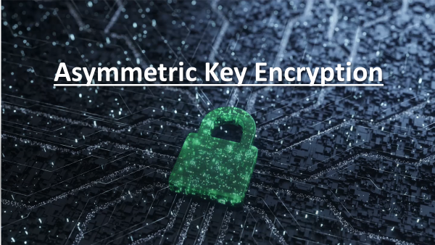

Slide 7
Asymmetric Key Encryption cont.
To address security vulnerabilities, a Linux administrator follows various best practices, such as the following.
• Disable unnecessary services.
• Enhance user management.
• Implement a stateful firewall to allow access from approved hosts only.
• Enhance logging and network time management.
• Implement an effective patch management system.
• Encrypt data at rest and in transit.
• Enforce logging of activities on the server.
• Implement security controls to protect against dictionary and brute force attacks.
• Enforce forensic deletion of files.

Slide 8
Asymmetric Key Encryption cont.
Among various symmetric and asymmetric encryption standards and tools available to protect important documents, gnu privacy guard (GPG) is an open source implementation of the pretty good privacy (PGP) asymmetric encryption protocol. It utilizes a pair of public and private keys to encrypt and decrypt files.
To encrypt data at rest and enforce forensic deletion of files we,
• implemented asymmetric key encryption using GPG; and
• permanently deleted files using the shred command
(see following slides)

Slide 9
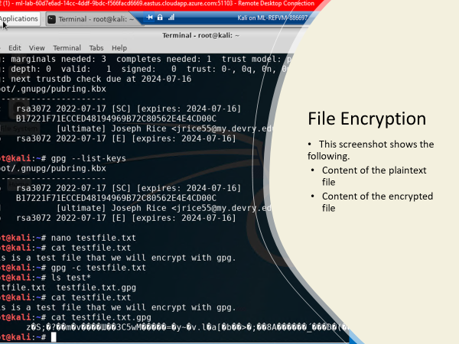

Slide 10
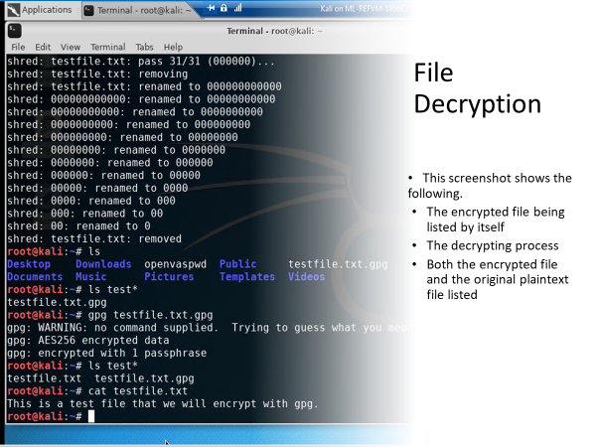

Slide 11
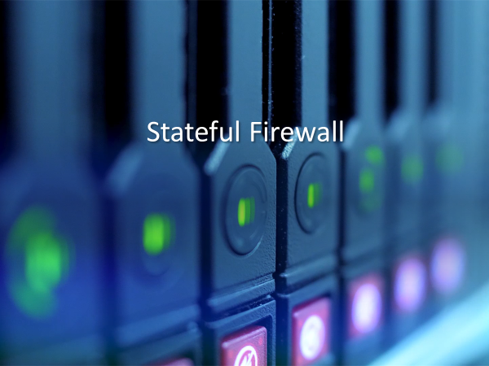

Slide 12
Stateful Firewall Cont.
Here I reviewed different networking and server attacks. As well as how to secure the different facets of a network.
Additionally, I looked at a holistic approach to administer and manage a secure network.
Explored how a firewall is used to protect enterprise computing resources from attacks.
I than hardened a Linux server by setting up a stateful firewall with iptables.
(see next two slides)

Slide 13
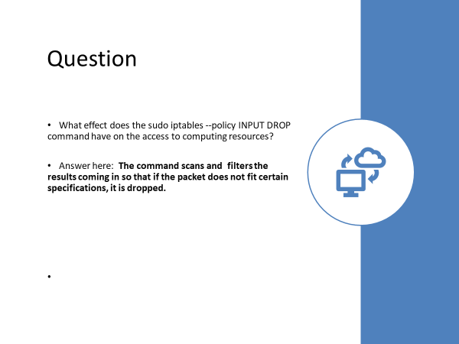
Stateful firewall cont.
I hardened a Linux server by setting up a stateful firewall with iptables.
                (see next two slides)

Slide 14
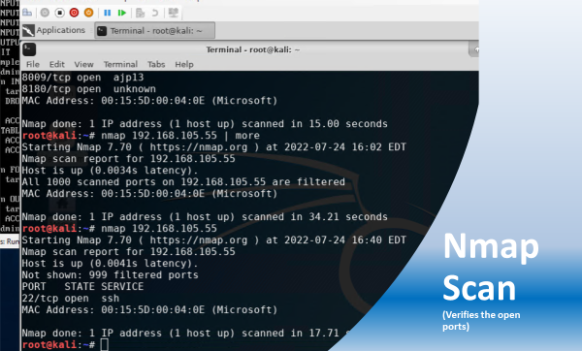

Slide 15
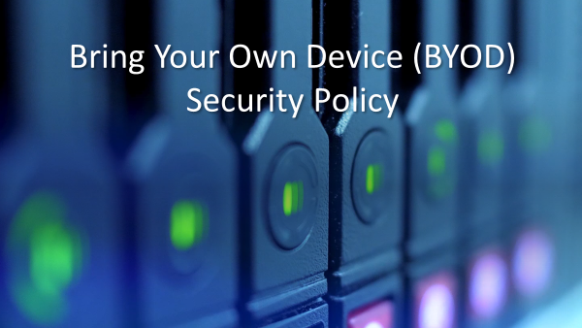

Slide 16
Bring Your Own Device Policy Cont.
Explored securing wireless networks, applications, and mobile devices
Created a bring your own device (BYOD) security policy for ABC Corporation based on a SANS security policy template.

Slide 17
BYOD Security Policy
This slide includes a self writtten completed security policy inserted as an object.

Slide 18
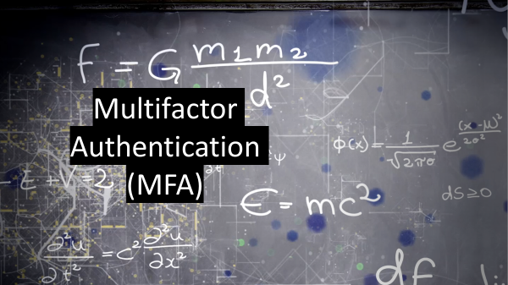

Slide 19
Multifactor Authentication Cont.
Discussed authentication and the secure management of user accounts that enforces authentication.
In addition, I was introduced to the principles and practices of access management. I was first taught what access management is and how to manage access through account management.
Second, I surveyed best practices for access control and ways to implement it.
Finally, I explored identity and access services.
As seen within the following slides, I implemented multifactor authentication (MFA) by adding a time-based one-time password (OTP) to the authentication process.
The one-time password was generated by using the Google Authenticator app.

Slide 20
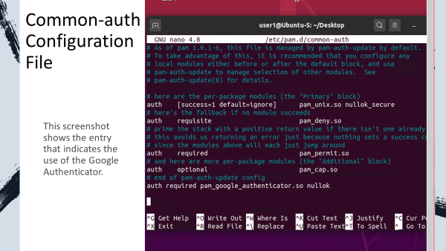

Slide 21
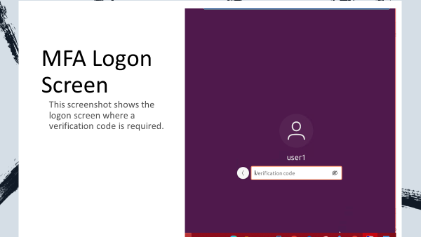

Slide 22
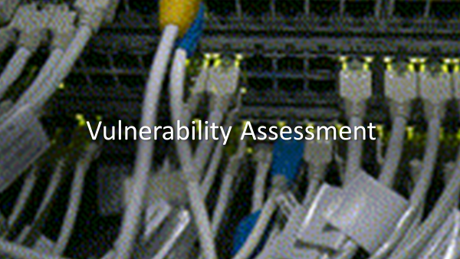

Slide 23
Vulnerability assessment cont.
I began by learning about vulnerability assessment and data security.
I used this information to understand how to create and maintain a business continuity plan.
Further, I used the vulnerability data to mitigate the risk within a business environment.
To conduct a vulnerability assessment of a server in a testing or production environment, I used tools such as NMAP (the network mapper), Netcat, and Wireshark. , which are used to assess the security posture of the Linux Server VM.
(see following slides for results)

Slide 24
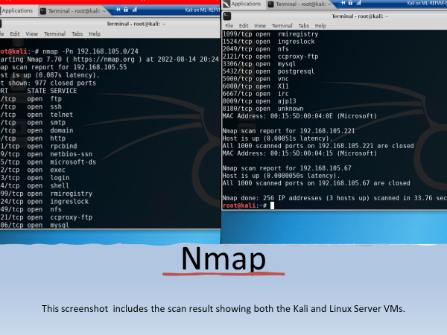
The NMAP tool can be used to identify IP addresses that are in use on a network segment, assuming that the hosts on the network segment are up and running.

Slide 25
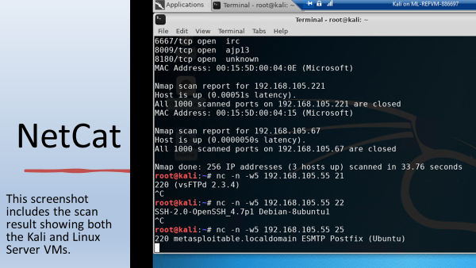
The NetCat tool can be used to gain information about FTP, SSH, and SMTP applications that are discovered in an NMAP scan (called banner grabbing). Knowing the version of an application running on the server can be a great help in the exploitation phase.

Slide 26
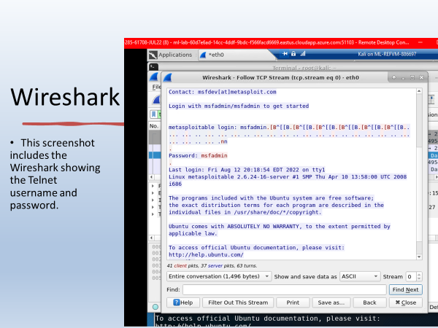
Wireshark is a packet sniffing tool. It can be used by security practitioners to analyze network traffic and gain insight into client and server applications.

Slide 27
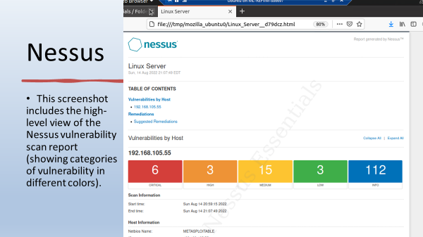
Nessus Essentials is a free vulnerability scanner that provides an entry point for vulnerability assessment.

Slide 28
Challenges Faced
Thankfully, I Did not come across any extremely challenging situations within this project. My previous knowledge and the in depth reading as well as detailed instructions were extremely helpful in contributing to one another making each part of this project a smooth process.

Slide 29
Career Skills Obtained
Established the fundamentals of information security attacks and defense mechanisms.
Broadened my knowledge on Security issues related to people, data, networks, and devices.
Gained an inside look at designing security solutions and policies.
Reviewed and Wrote practices that support the security principles of confidentiality, integrity, and availability
Recognize malware and social network attacks
Breakdown algorithims
Ability to survery a security network.
Knowledge on wireless network security solutions.
Understanding of application security, device security, and physical security.
Knowledge on authentication and access control techniques.
Utilizing business continuity and risk management strategies.
Establish a secure network.

Slide 30

Conclusion
Sec285 Has broadened my knowledge and previous skill set by going in depth with security measures and policies that we follow today.
By utilizing a range of functions, I was able to benefit from hands on simulations by creating, launching, testing and shutting down various applications within a virtual world.

